Slide 1





XX Encuentro de Cooperación Farma-Biotech
28 de abril de 2021
Bacteria-trained lymphocytes as novel anti-cancer immunotherapy
Esteban Veiga

Slide 2
XX Encuentro de Cooperación Farma-Biotech
Content
1. The Research Group
2. The Product
3. Partnering Opportunities
a) Target Indications
b) Innovative mechanisms of action
c) Differential features facing the market
d) Current status of development
e) IPR protection
f) Pitfalls & Risks to be considered

Slide 3
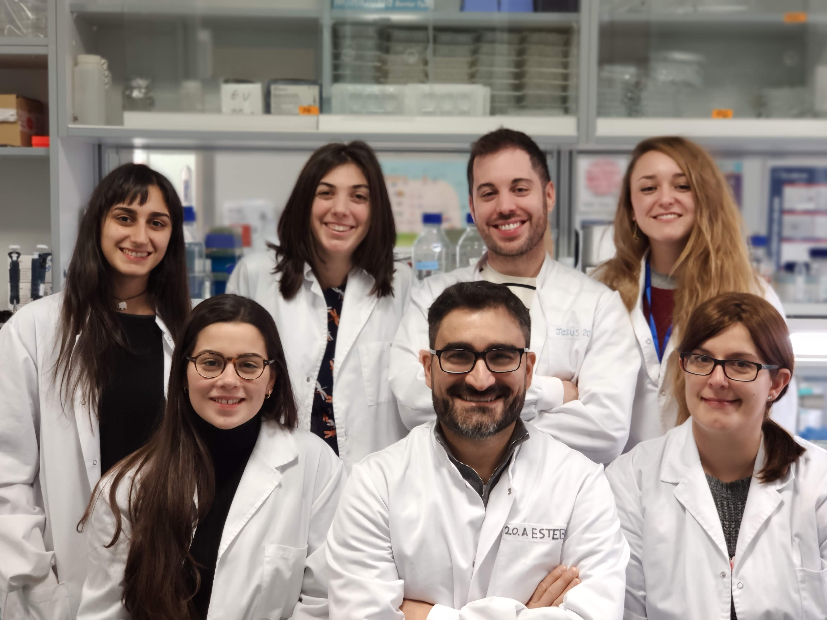
XX Encuentro de Cooperación Farma-Biotech
1. The Research Group
https://www.youtube.com/watch?v=t7fGJupPEvI&feature=emb_logo

Slide 4
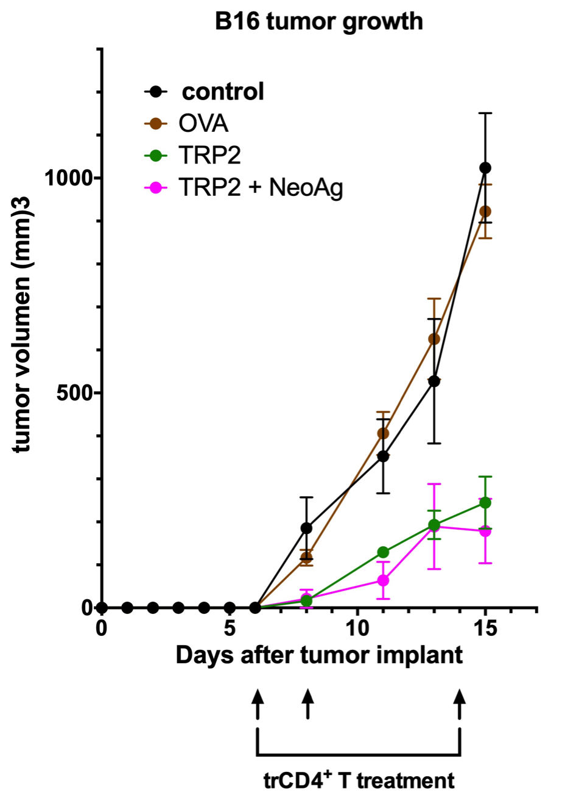
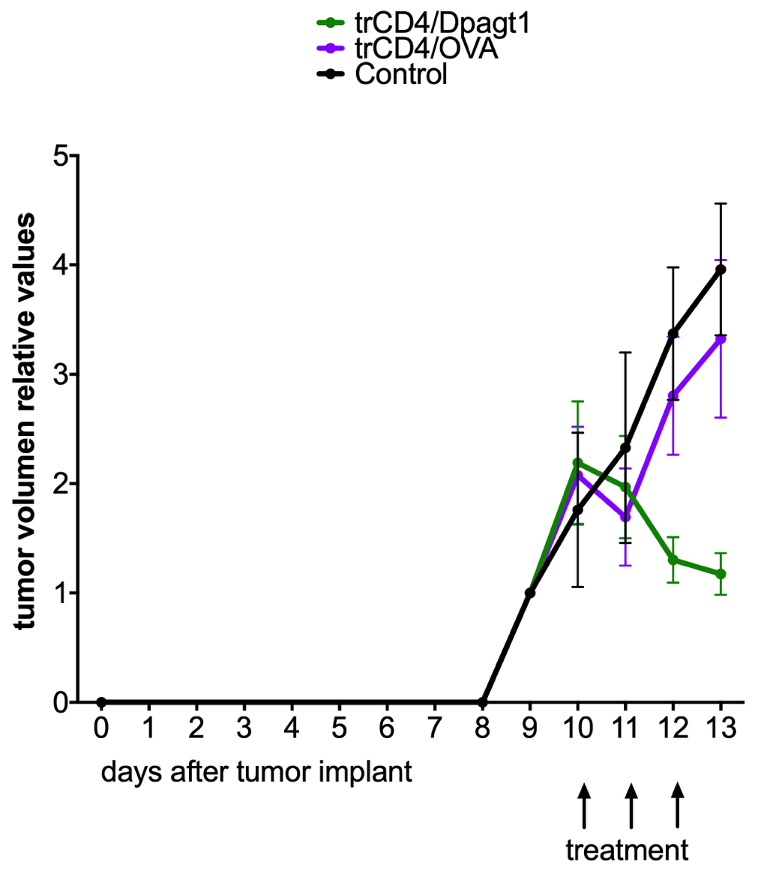
XX Encuentro de Cooperación Farma-Biotech
2. The Product
a) Target Indications: Immunogenic tumors. Tested against melanoma and non-orthotopic colon cancer

Slide 5
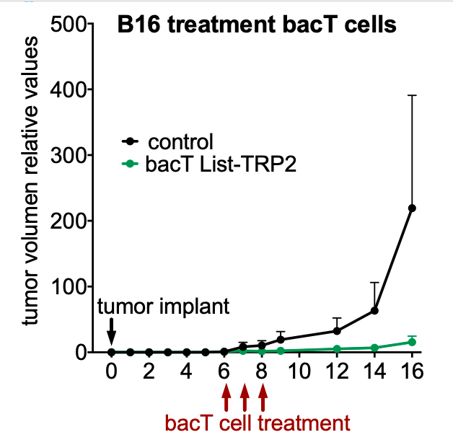
XX Encuentro de Cooperación Farma-Biotech
2. The Product
a) Target Indications: Immunogenic tumors. Tested against melanoma and non-orthotopic colon cancer
Therapy using Bact against B16 melanoma increasing 3x the number of BacT cells

Slide 6
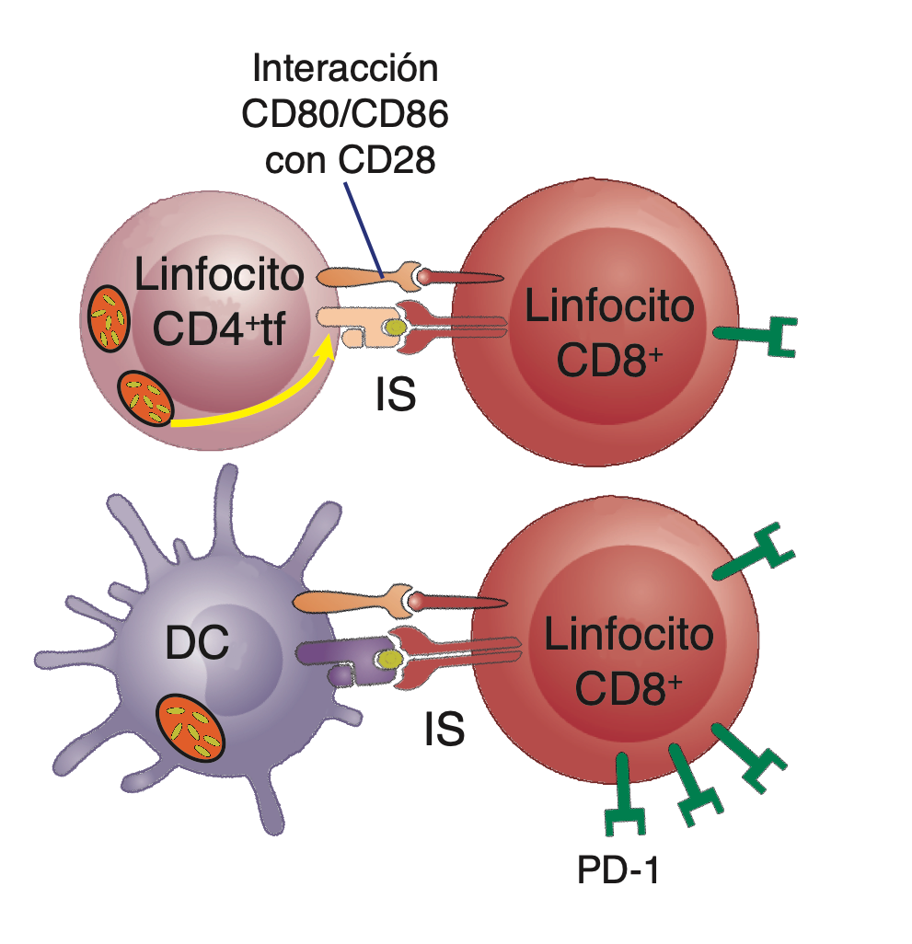




XX Encuentro de Cooperación Farma-Biotech
2. The Product
b) Innovative mechanisms of action: Newly discovered cross-presentation mediated by BacT
CD8+ T
T CD4+
CD8+ T
CD40L
DC
T CD4+
Cruz-Adalia, A. et al. Conventional CD4+ T cells present bacterial antigens to induce cytotoxic and memory CD8+ T cell responses. Nat. Commun. 8, 1591 (2017).

Slide 7
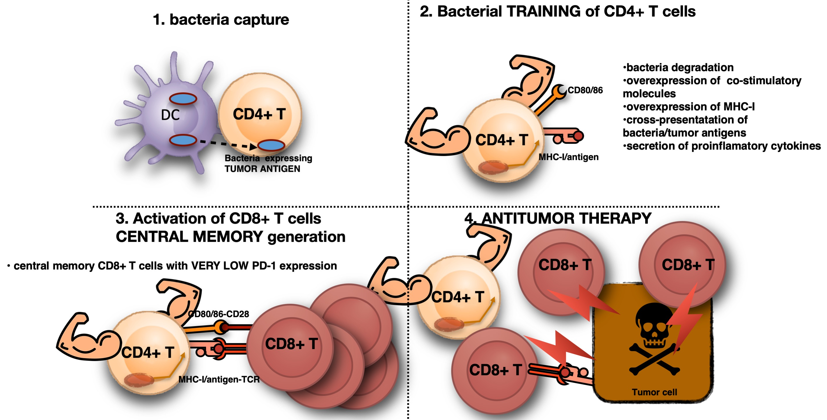
XX Encuentro de Cooperación Farma-Biotech
2. The Product
b) Innovative mechanisms of action: Newly discovered cross-presentation mediated by BacT

Slide 8
XX Encuentro de Cooperación Farma-Biotech
2. The Product
c) Differential features facing the market:
There exist several cellular cancer immunotherapies, most of them fail by the immunosuppressive ambient of solid tumors. Our technology based in bacteria-trained lymphocytes potently activates CD8+ T cells that eliminate malignant tumor cells. The most closed therapy could be DC-based vaccines (with very low response rates). We know that BacT cells activate CD8+ T cells in a different way that DC do. BacT-mediated activation of CD8+ T cells increased their metabolic activity and the proliferative potential, and importantly induces the differentiation towards central memory, the population more resistant to exhaustion i.e. BacT cells induce responses more desirable to fight against tumors.
Other close immunotherapies are CAR-T and TILs. CAR-T have been shown to be effective against liquid tumors but show very poor effects against solid tumors. BacT induce immune responses resistant to exhaustion without the need to genetically manipulations of human cells. Proof of concept experiments show strong responses against solid tumors using BacT technology.
Respect TILs, the principal advantage of BacT is again the activation of CD8+ T cells that, in contrast to TILs, will resist to exhaustion.

Slide 9
XX Encuentro de Cooperación Farma-Biotech
2. The Product
d) Current status of development: TRL4
We have performed proof of concept experiments demonstrating that BacT cells impeded the implantation of the tumor as well as tumor growth. Mice vaccination with bacT cells impeded the implantation of aggressive melanoma. BacT cells were useful not only at preventive but also at therapeutic level, we tested BacT against already established tumors using B16 melanoma and MC38 (colon cancer; non orthotopic). In both models a clear reduction of tumor growth was observed. In order to achieve this task, we engineered bacteria expressing tumor-associate antigens. Note that in these preliminary experiments, we used 100x less cells than the equivalent (taking into account the weight differences between species) used in TILs therapies in humans, and we used only 3 doses when other experiments uses up to seven inoculations of the treatment.

Slide 10
XX Encuentro de Cooperación Farma-Biotech
2. The Product
e) IPR protection.
We have protected by a patent, the use of bacT cells in cancer immunotherapies and this patent has been extended to the USA, Canada, EU and Australia. In Spain: P201531177

Slide 11
XX Encuentro de Cooperación Farma-Biotech
2. The Product
f) Pitfalls & Risks to be considered:
1. We need to test BacT aganst other tumor models. We will test whether bacT cells (capturing bacteria-expressing tumor associated antigens) are able to destroy stablished tumors using mice and human tumors models in immunocompentent mice as well as in humanized/immunodeficient mice. These milestones will consolidate the data from our proof of concept models. This will take aprox 2 years
2. We will optimize engineered bacteria for BacT training. We know that Listeria monocytogenes (but not Escherichia coli or Salmonella enterica) is able to train CD4+ T cells and it is in our aim to engineer bacteria that would improve bacT-mediated anti-tumor responses. These bacteria will express known tumor associated antigens (TAA) and predicted neoantigens (TNA). We will analyze whether we can improve our current data in terms of tumor destruction. The engineered bacteria will be also protected by patents. Note that not all bacteria are able to include the lymphocyte training. We have data on the molecular mechanisms of bacteria-induced training that would help us to design better bacteria. This would be done in 18-24 months
3. regarding the points 1 and 2 we will chose a tumor model and a engineered bacterium (the combination of training bacterium/tumor showing the best results in mice) in order to design a phase 1 clinical assay in humans. Hopefully this could start before year 4 of the project.

Slide 12
XX Encuentro de Cooperación Farma-Biotech
3. Partnering Opportunities
We would like to strengthen the possibility to transfer these discoveries to the society. Ideally be by founding a Spin-Off company or by licensing the patent.

